Slide 1
App Services Developer’s Guide to Windows 10

Slide 2
Agenda
What are App Services?
App Services Scenarios
App Services Client
App Services Server
Debugging Tips
Debugging an App Service
App Services Details
App Service Lifetime
Implementing a client SDK
Controlling Access
Versioning

Slide 3
What are App Services?

Slide 4
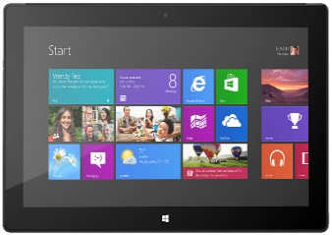
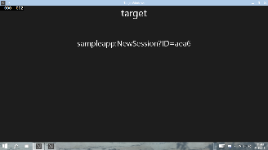




App Service: Special case of Background Task
Client App A
App with App Service
Background Task
Client App B

Slide 5

Scenario: Bar Code Scanning
Bar Code decoding App Service
Image bytes in ValueSet or FileToken
Decoded data

Slide 6


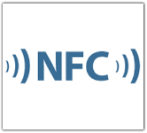

Scenario: Enterprise suite of apps
Client App A
App Service
Maintains Inventory cache
Interact with cloud services
Client App B
App Service
Proximity Reading Services

Slide 7
Think of App Services as ‘Web services on device’

Slide 8
App Services – Client
AppServiceConnection connection = new AppServiceConnection(); connection.AppServiceName = "microsoftDX-appservicesdemo"; connection.PackageFamilyName = "24919ArunjeetSingh.InstapaperIt"; AppServiceConnectionStatus connectionStatus = await connection.OpenAsync(); if (connectionStatus == AppServiceConnectionStatus.Success) { //Send data to the service var message = new ValueSet(); message.Add("Command", "CalcSum"); message.Add("Value1", Int32.Parse(Value1.Text)); message.Add("Value2", Int32.Parse(Value2.Text)); //Send message and wait for response AppServiceResponse response = await connection.SendMessageAsync(message); if (response.Status == AppServiceResponseStatus.Success) { int sum = (int)response.Message["Result"]; new MessageDialog("Result=" + sum).ShowAsync(); } }

Slide 9
App Services – Service (1/2)
namespace AppServicesDemoTask { public sealed class AppServiceTask : IBackgroundTask { private static BackgroundTaskDeferral _serviceDeferral; public void Run(IBackgroundTaskInstance taskInstance) { var appService = taskInstance.TriggerDetails as AppServiceTriggerDetails; if (appService.Name == "microsoftDX-appservicesdemo") { // Hook up the RequestReceived event handler appService.AppServiceConnection.RequestReceived += RequestReceived; } } ...

Slide 10
App Services – Service (2/2)
private async void RequestReceived(AppServiceConnection sender, AppServiceRequestReceivedEventArgs args) { var message = args.Request.Message; // This service uses a Command keyed entry for the client to invoke services from the App Service string command = message["Command"] as string; switch (command) { case "DoIt": { var messageDeferral = args.GetDeferral(); int value1 = (int)message["Value1"]; ... Do some processing //Set a result to return to the caller var returnMessage = new ValueSet(); returnMessage.Add("Result", result); var responseStatus = await args.Request.SendResponseAsync(returnMessage); messageDeferral.Complete(); break; } ... } }

Slide 11
Declaring App Service
<?xml version="1.0" encoding="utf-8"?> <Package xmlns="http://schemas.microsoft.com/appx/manifest/foundation/windows10" ... >
<Applications> <Application Id="App“ ... > <Extensions> <uap:Extension Category="windows.appService“ EntryPoint="AppServicesDemoTask.AppServiceTask"> <uap:AppService Name="microsoftDX-appservicesdemo" /> </uap:Extension> </Extensions> </Application> </Applications> <Capabilities> <Capability Name="internetClient" /> </Capabilities> </Package>

Slide 12
Two-way Communication
Client and server can keep a two-way chatty communication channel open
Client can attach a RequestReceived event handler to its own AppServiceConnection instance
Both client and server can send and receive messages
AppServiceConnectionStatus connectionStatus = await connection.OpenAsync(); if (connectionStatus == AppServiceConnectionStatus.Success) { connection.RequestReceived += OnRequestReceived; }

Slide 13
Debugging Tips
Getting the PackageFamilyName for the App Service
Debugging your App Service

Slide 14
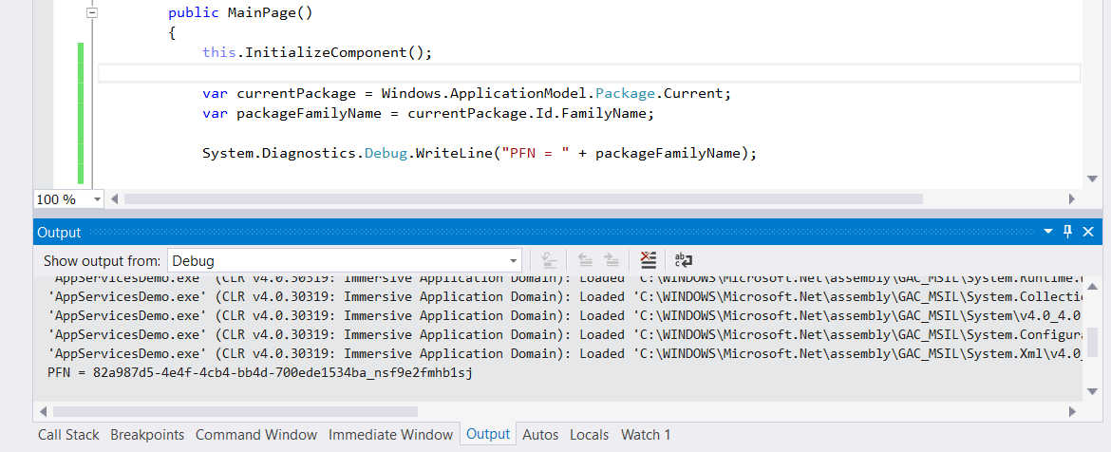
Getting the Service PackageFamilyName
‘Store – Associate App with the Store’ sets the store assigned PackageFamilyName
You don’t have to associate your app for testing!
Call Package.Current.Id.FamilyName to return PFN to use in debugging

Slide 15
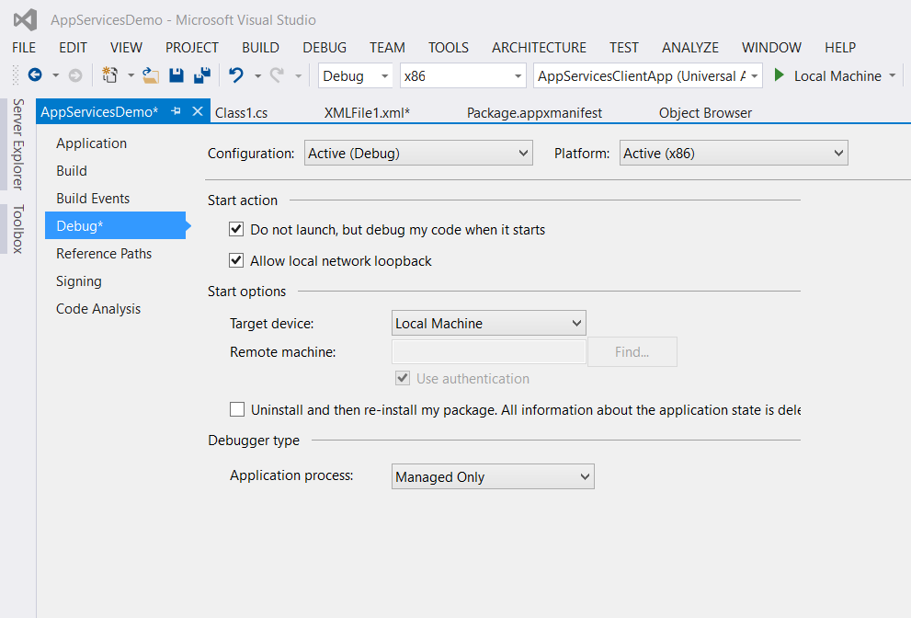
Debugging App Services
Set breakpoints in app service code
Check ‘Do not launch but debug my code when it starts’ in project properties
Launch app service foreground app in debugger – nothing happens!
Run client app to connect to app service
Debugger attaches and breaks on your breakpoint

Slide 16
Demo: App Services

Slide 17
More considerations on App Services…

Slide 18
App Service Lifetime
Service is activated on-demand
Background Task activated by means of an AppServiceTrigger
Client may terminate service by disposing its AppServiceConnection
You can build in capability for your service to shutdown through a message from a client
If the invoking app is suspended, app services sponsored by the app will be terminated
Insufficient resources may cause launch failure or service termination
Invoking app will get AppServiceConnectionStatus.ResourcesNotAvailable when connecting
May get AppServiceResponseStatus.ResourceLimitsExceeded when sending message

Slide 19
What Protocol?
App Services are designed to be flexible and light-weight and are modelled on web REST Web services
Simple Request-Response message API
Data packaged as string-keyed ValueSets
Easy to use with multiple different payloads
When you publish an App Service, you are defining a communications endpoint
An App Service endpoint provides the Caller a way to send data to the Callee
An App Service endpoint also provides the Caller a way to request return values from the Callee and for the Callee to respond with these return values.

Slide 20
App services provides another way for applications to communicate with each other

Slide 21
Nice to do: Implementing a Client SDK ☺
Wrap the low-level service communication implementation details inside a more functional set of methods
Publish a client SDK for your service
Distribute as a NuGet package or by other means

Slide 22
Can I restrict access to my App Service?
Build your own caller validation mechanisms on top of app services
Simplest is for service provider to whitelist callers based on their PackageFamilyName
PackageFamilyName of caller is passed with every request
Possible to build more complicated caller validation mechanisms on top of ValueSets once a connection has been established
Whitelist could be followed by explicit X.509 certificate exchange

Slide 23
Versioning
Follow the Web REST API versioning model
If you need to make a breaking change to an App Service endpoint, you must expose a new endpoint and provide backward compatibility with the old one

Slide 24
Demo: App Services client library

Slide 25
Final Thoughts…
It’s not just about XAML Windows App clients!
See Calling an App Service from a WPF/WinForms Win32 App
https://aruntalkstech.wordpress.com/2015/07/20/calling-an-app-service-from-a-wpfwinforms-win32-app/
Contact Arun at @aruntalkstech

Slide 26
Review
What are App Services?
App Services Scenarios
App Services Client
App Services Server
Debugging Tips
Debugging an App Service
App Services Details
App Service Lifetime
Building a client API
Controlling Access
Versioning

